Slide 1
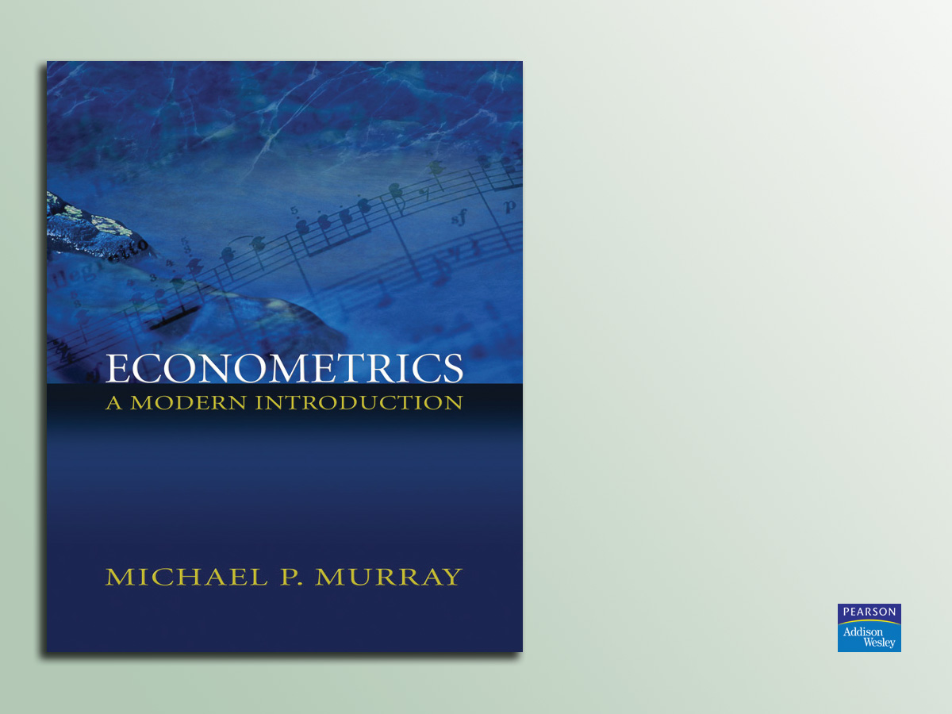
Lecture 12:
Joint Hypothesis Tests
(Chapter 9.1–9.3, 9.5–9.6)

Slide 2

Today’s Agenda
Review
Joint Hypotheses (Chapter 9.1)
F-tests (Chapter 9.2–9.3)
Applications of F-tests (Chapter 9.5–9.6)

Slide 3
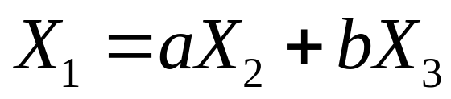
Review
Perfect multicollinearity occurs when
2 or more of your explanators are jointly perfectly correlated.
That is, you can write one of your explanators as a linear function of
other explanators:

Slide 4
Review (cont.)
OLS breaks down with perfect multicollinearity (and standard errors blow up with near perfect multicollinearity).
Multicollinearity most frequently occurs when you want to include:
  Time, age, and birth year effects
  A dummy variable for each category, plus
  a constant

Slide 5
Review (cont.)
Dummy variables (also called binary variables) take on only the values 0 or 1.
Dummy variables let you estimate separate intercepts and slopes for different groups.
To avoid multicollinearity while including a constant, you need to omit the dummy variable for one group (e.g. males or
non-Hispanic whites). You want to pick one of the larger groups to omit.

Slide 6
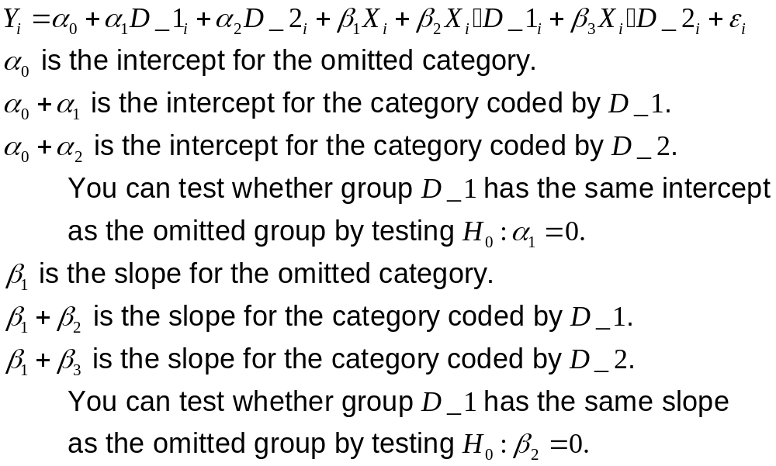
Review (cont.)

Slide 7
Review (cont.)
You can multiply 2 variables together to create interaction terms.
Interaction terms let the slope of each variable depend on the value of the other variable.

Slide 8
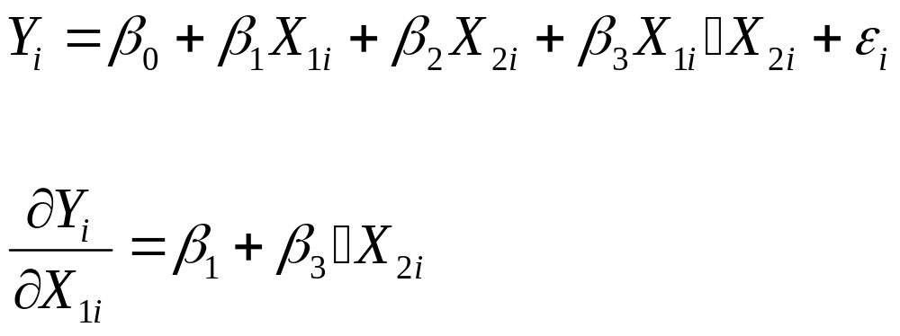
Review (cont.)

Slide 9
Review (cont.)
With many of the specifications covered last time, we encountered hypotheses that required us to test multiple conditions simultaneously. For example, to test:
  All categories have the same intercept (with 3 or more categories)
  All categories have the same slope (with 3 or
  more categories)
  One explanator has no effect on Y, when that explanator has been used in an interaction term

Slide 10
Review (cont.)
In economics, many processes are
non-linear. Economic theory relies heavily on diminishing marginal returns, decreasing returns to scale, etc.
We want a specification that lets the 50th unit of X have a different marginal effect than the 1st unit of X.

Slide 11
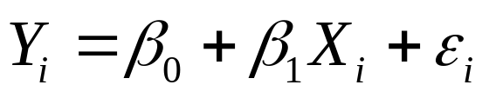
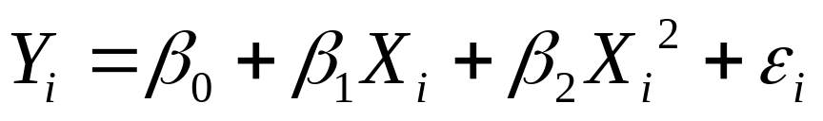
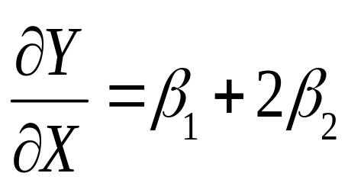
Review (cont.)
If we regress not
but rather
then the marginal benefit of a unit of X changes to:

Slide 12
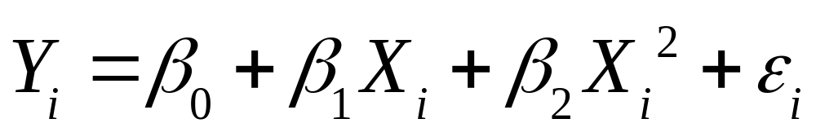
Review (cont.)
If β₂ > 0, then the marginal impact of X
is increasing. If β₂ = 0, then X has a constant marginal effect. If β₂ < 0, then the marginal impact of X is decreasing.

Slide 13
Review (cont.)
If β₂ > 0 and β₃ < 0, then this equation traces an inverse parabola.
Earnings increases quickly in experience at first, but then flattens out.

Slide 14
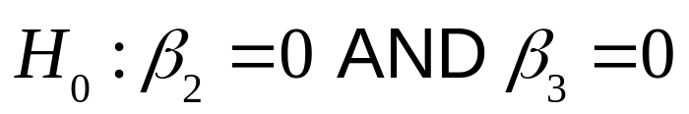
Joint Hypotheses (Chapter 9.1)
To test the hypothesis that experience is not an explanator of log(earnings), you need to test
WARNING: you CANNOT simply look individually at the t-test for β₂ = 0 and the t-test for β₃ = 0

Slide 15
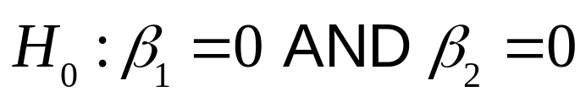
Joint Hypotheses (cont.)
You CANNOT test a JOINT hypothesis by combining multiple t-tests.
Suppose you are testing
A t-test rejects β₁ = 0 if the data would be very surprising to see, given that
β₁ = 0. A t-test does NOT reject β₁ = 0 if the data would only be pretty surprising.

Slide 16
Joint Hypotheses (cont.)
Each t-test could fail to reject the null if the data would only be “pretty surprising” under each null, taken one at a time.
However, it might be “very surprising” to see two “pretty surprising” events.
We do not know the “size” of a joint test conducted by stacking together many t-tests.

Slide 17
Joint Hypotheses (cont.)
Another problem with t-tests: suppose X₁ and X₂ are heavily correlated with each other (though not so much as to create perfect multicollinearity). Then each coefficient will have a large standard error.

Slide 18
Joint Hypotheses (cont.)
Another problem with t-tests: suppose X₁ and X₂ are heavily correlated with each other.
If you remove either variable—leaving
in the other—then you lose very little explanatory power. The other variable simply picks up the slack (through the omitted variables bias formula).

Slide 19
Joint Hypotheses (cont.)
However, to test the null hypotheses that neither variable has explanatory power, we want to consider removing both variables at the same time. The two of them together may share a lot of explanatory power, even if either one could do the job nearly as well as both together.
We need a new type of test, that lets us consider multiple hypotheses at once.

Slide 20
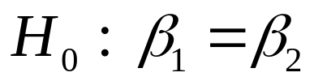
Joint Hypotheses (cont.)
Simply including more than one coefficient in the hypothesis does NOT make a joint hypothesis. For example, suppose you believed that X₁ and X₂ had identical effects. You could test this claim with:
This test is a single hypotheses, and can be tested using a t-test. The calculation requires you to know the covariance of the two coefficients. See Chapter 7.5.

Slide 21
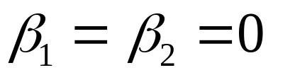
Joint Hypothesis (cont.)
A joint hypothesis tests more than one condition simultaneously. The easiest way to see how many conditions are being tested is to count the number of equal signs.
E.g. H₀ : β₁ = 0 AND β₂ = 0 has two equal signs, so there are two conditions being tested. This is a joint test.
This hypothesis is often written

Slide 22
F-tests (Chapter 9.2–9.3)
How can we test multiple conditions simultaneously?
Intuition: run a regression normally,
and then also run a regression where you assume the conditions are true. See if imposing the conditions makes a big difference.

Slide 23
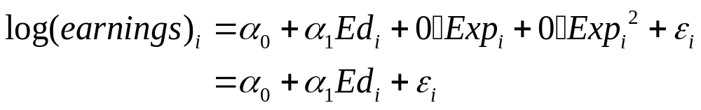
F-tests (cont.)
To test the hypothesis that experience is not an explanator of log(earnings), you need to test H₀ : β₂ = 0 AND β₃ = 0
If these conditions are true, then there should be little difference between our “unrestricted” regression and the “restricted” version:

Slide 24
F-tests (cont.)
If the conditions we are testing are true,
then there should be little difference between our “unrestricted” regression and the “restricted” version.
What do we mean by “little difference”?
Does imposing the restrictions we wish to
test greatly affect the model’s ability to fit
the data?
We can turn to our measure of fit, R²

Slide 25
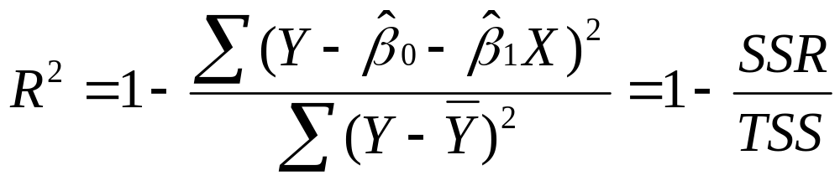
F-tests (cont.)
To measure the difference in the quality of fit before and after we impose the restrictions we are testing, we can turn to our measure of fit, R²
Notice that the Total Sum of Squares is the same for both versions of the regression, so we can focus on the Sum of Squares of
the Residuals.

Slide 26
F-tests (cont.)
Does imposing the restrictions from our null hypothesis greatly increase the SSR ? (Remember, we want a low SSR.)
Run both regressions and calculate the SSR.
Call the SSR for the unrestricted version
the SSR^{u}
Call the SSR for the restricted version
the SSR^{r}

Slide 27
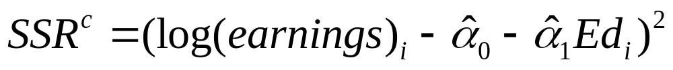
F-tests (cont.)
Call the SSR for the unconstrained version the SSR^{u}
Call the SSR for the constrained version
the SSR^{c}
If the null hypothesis (β₂ = β₃ = 0) is true,
then imposing the restrictions will not change the SSR much. We will have a “small”
SSR^{c}-SSR^{u}

Slide 28
F-tests (cont.)
If the null hypothesis is true, then imposing the restrictions will not change the SSR much. We will have a “small” SSR^{c}-SSR^{u}
Remember, OLS finds the smallest possible SSR. So SSR^{c} > SSR^{u}
The more restrictions we impose, the larger SSR^{c} will get, even if the restrictions are true.
We need to adjust for the number of restrictions (r) we impose.

Slide 29
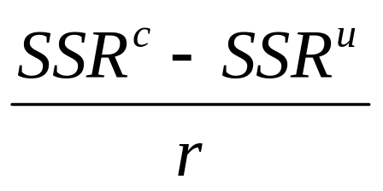
F-tests (cont.)
To measure how large an effect our constraints have, look at:
What constitutes a large difference? We want to compare the difference in SSR to the original SSR^{u}. An increase of 100 units is more worrisome if we start from SSR^{u} = 200 than if SSR^{u} = 20,000.

Slide 30
F-tests (cont.)
The more data we have, the more we trust our unconstrained regression.
Also, the more data we have, the more seriously we want to take a deterioration in SSR.
To capture the effect of more data, we weight by n-k-1.

Slide 31
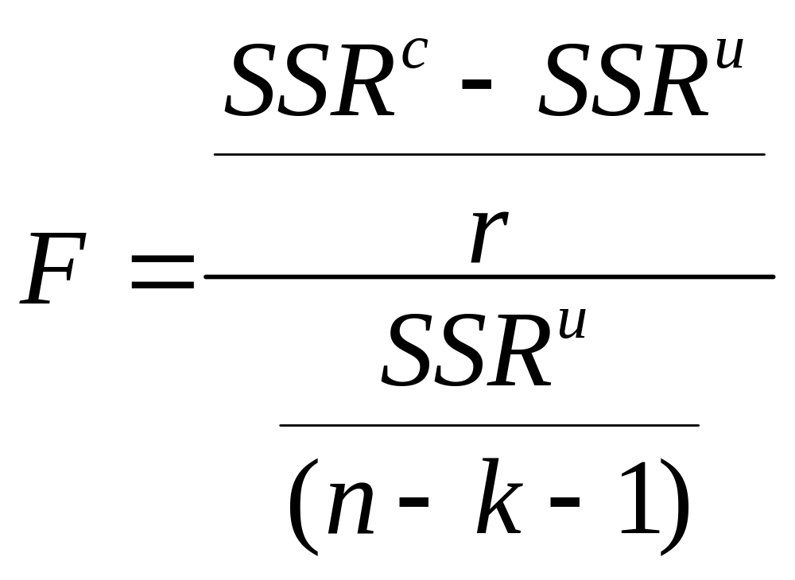
F-tests (cont.)

Slide 32
F-tests (cont.)
When the ε_{i} are distributed normally, the
F-statistic will be distributed according to the
F-distribution with r, n-k-1 degrees of freedom.
We know how to compute an F-statistic from the data.
We know the distribution of the F-statistic under the null hypothesis.
The F-statistic meets all the needs of a
test statistic.

Slide 33
F-tests (cont.)
If our null hypothesis is true, then imposing the hypothesized values as constraints on the regression should not change SSR much. Under the null, we expect a low value of F.
If we see a large value of F, then we can build a compelling case against the null hypothesis.
The F-table tells you the critical values of F for different values of r and n-k-1.

Slide 34
F-tests (cont.)
Let’s return to the earnings test example, with the polynomial specification
To test the hypothesis that experience is
not an explanator of log(earnings), you need
to test

Slide 35
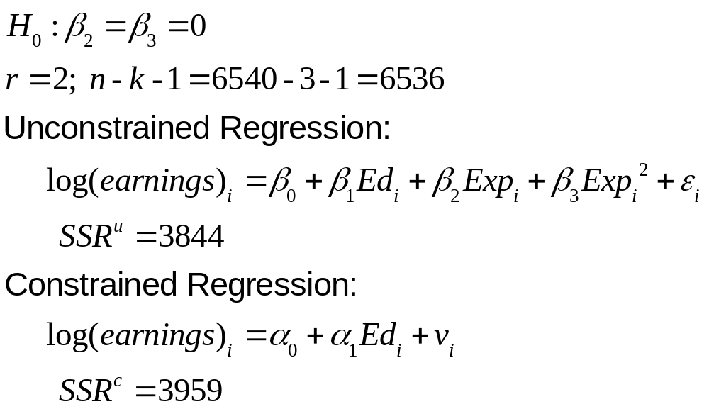
F-tests (cont.)

Slide 36
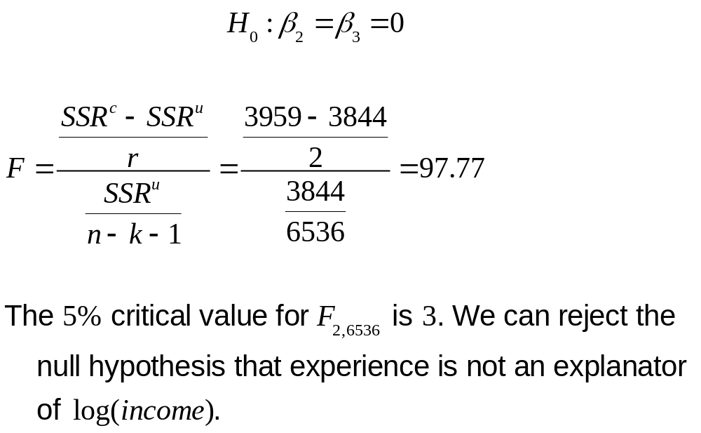
F-tests (cont.)

Slide 37
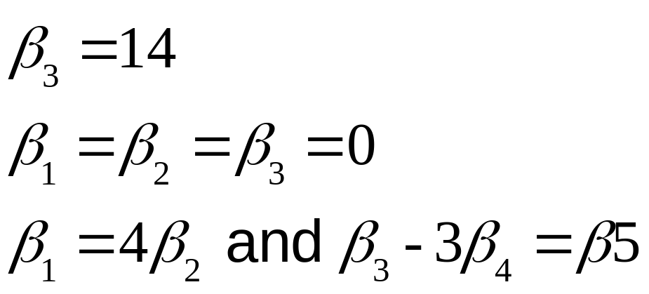
F-tests (cont.)
Note: we must be able to impose the restrictions as part of an OLS estimation. We can impose only linear restrictions.
For example, we CAN test:

Slide 38
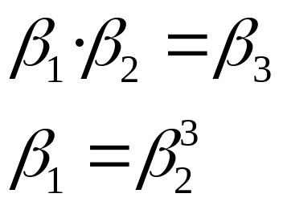
F-tests (cont.)
However, we CANNOT test:

Slide 39
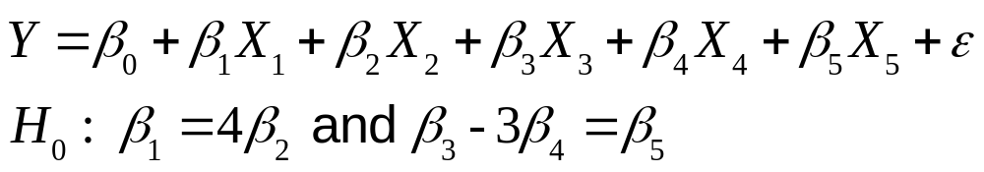
F-tests (cont.)
Example:
There are two equal signs. r = 2.
How do we impose the restrictions?
How do we enter this regression into
the computer?

Slide 40
F-tests (cont.)
To enter a regression into the computer, we need to regroup so that all our explanators receive a single coefficient apiece.
We need to transform this expression from
one with separated explanators and linear combinations of coefficients to one with separated coefficients and linear combinations of explanators.

Slide 41
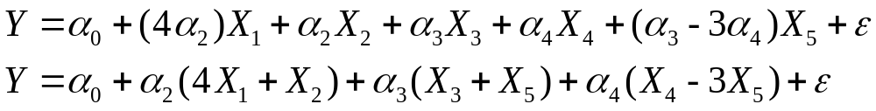
F-tests (cont.)
To find the constrained sum of squares, we need to regress Y on a constant,
(4X₁+X₂), (X₃+X₅), and (X₄ -3X₅). The
SSR from this regression is our SSR^{c}.

Slide 42
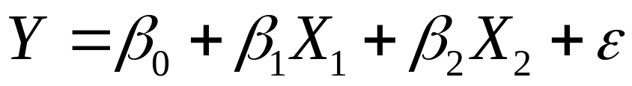
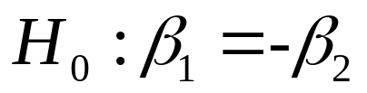
Checking Understanding
You regress
You want to test
What are the constrained and unconstrained regressions? What is r ?

Slide 43
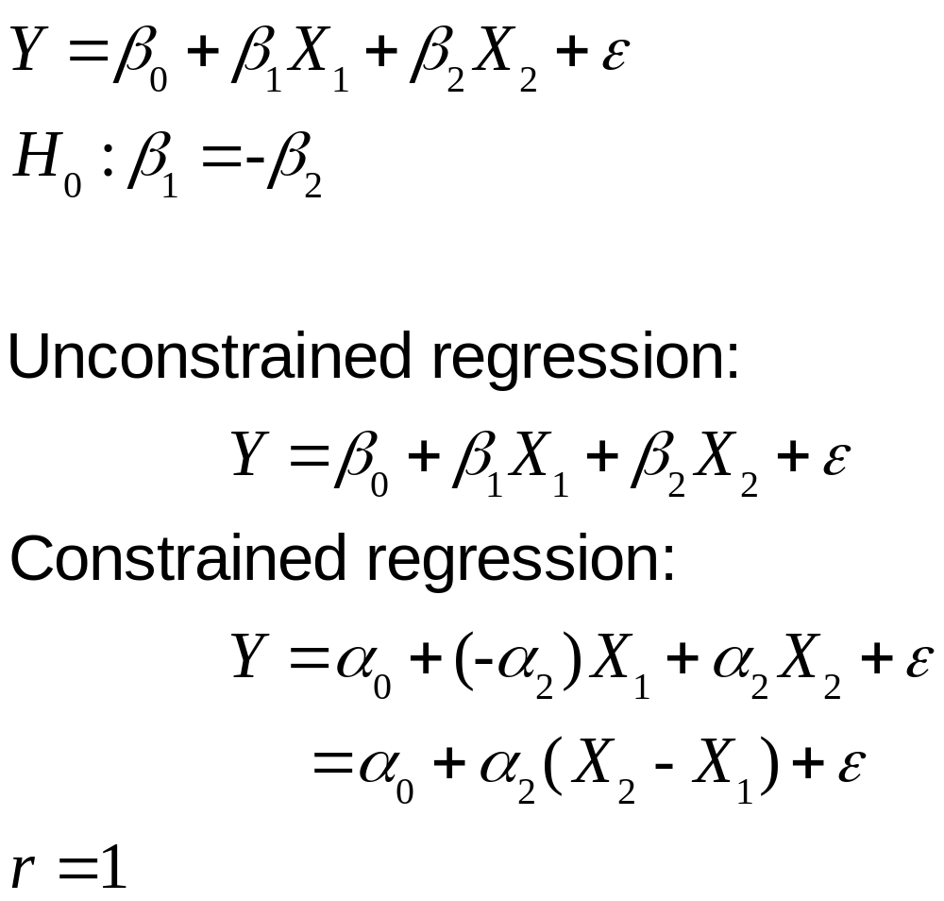
Checking Understanding (cont.)

Slide 44
F-tests
Note: when r = 1, you have a choice between using a t-test or an F-test.
When r = 1, F = |t|². F-tests and t-tests will give the same results.
When r > 1, you cannot use a t-test.

Slide 45
F-tests (cont.)
A frequently encountered test is the null hypothesis that all the coefficients (except the constant) are 0. This test asks whether the entire model is useless. Do our explanators do a better job at predicting Y than simply guessing the mean?
Many econometrics programs automatically calculate this F-statistic when they perform
a regression.

Slide 46
An Application of F-tests (Chapter 9.5)
Let’s use F-tests to re-examine the differences in earnings equations between black women and black men in the NLSY.
Regress the following for black workers:
where Ed_{i} = years of education,
Exp_{i} = years of experience, and
D_F_{i} = 1 if the worker is female

Slide 47
An Application of F-tests (cont.)
To test whether black males and black females have the same intercept, we can use a simple t-test with
H₀ : β₃ = 0
Our estimated coefficient is -0.201 with a standard error of 0.036, yielding a t-statistic of -5.566
This t-statistic exceeds our critical value of -1.96
We can reject the null hypothesis at the 5% level

Slide 48
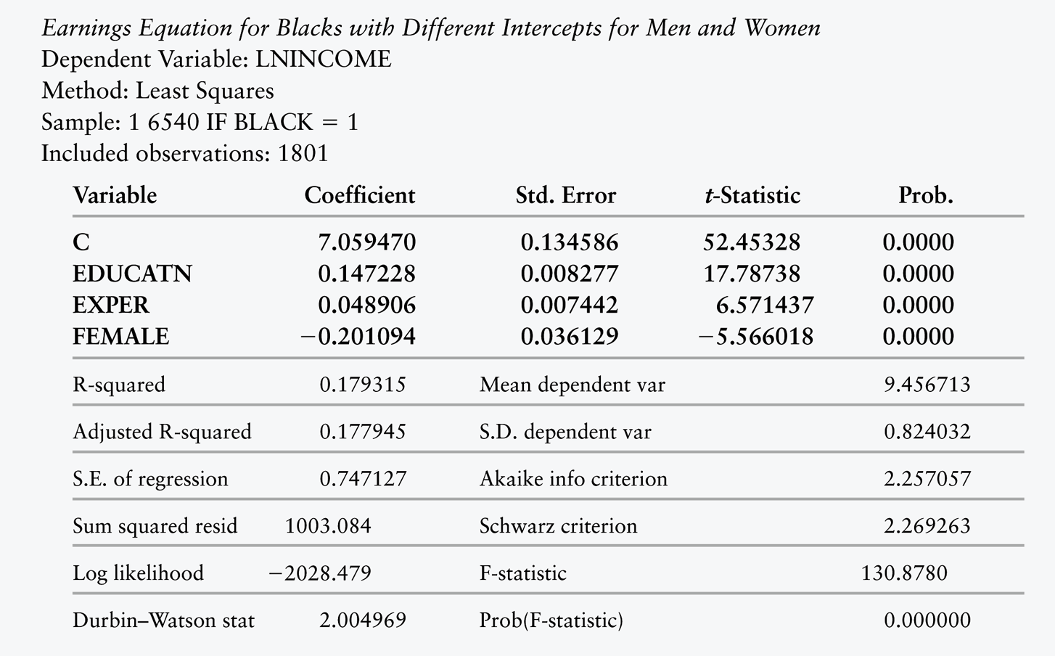
TABLE 9.1 Earnings Equation for Black Men and Women (NLSY Data)

Slide 49
An Application of F-tests (cont.)
We have rejected the null hypothesis that black men and black women have the same intercept.
Could they also have different slopes
for education and experience?
We can use dummy variable
interaction terms.

Slide 50
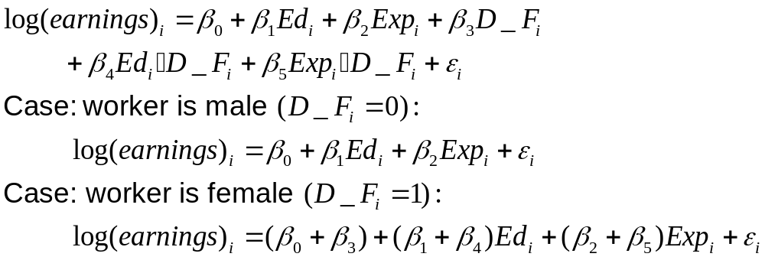
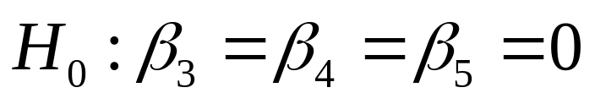
An Application of F-tests (cont.)
To test the null hypothesis that black men and black women have identical earnings equations, we need to test the joint hypothesis:

Slide 51
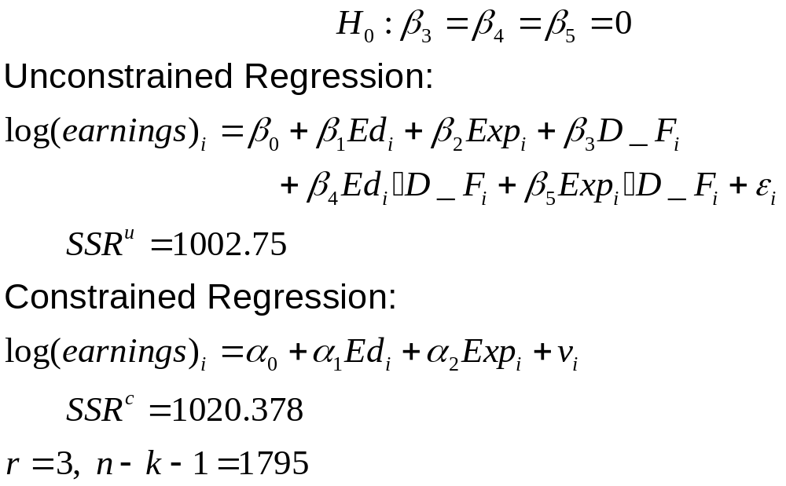
An Application of F-tests (cont.)

Slide 52
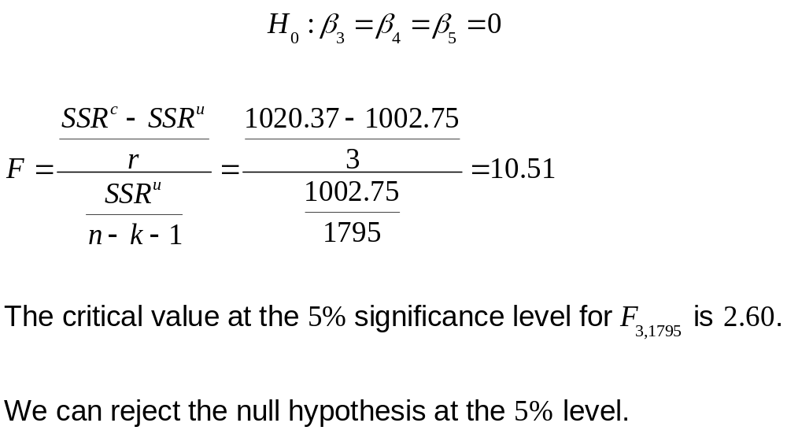
An Application of F-tests (cont.)

Slide 53
An Application of F-tests (cont.)
We can reject the null hypothesis that black men and black women have identical earnings functions.
Do we really need the interaction terms, or do we get the same explanatory power by simply giving black women a different intercept?
Let’s test the null hypothesis that the interaction coefficients are both 0.

Slide 54
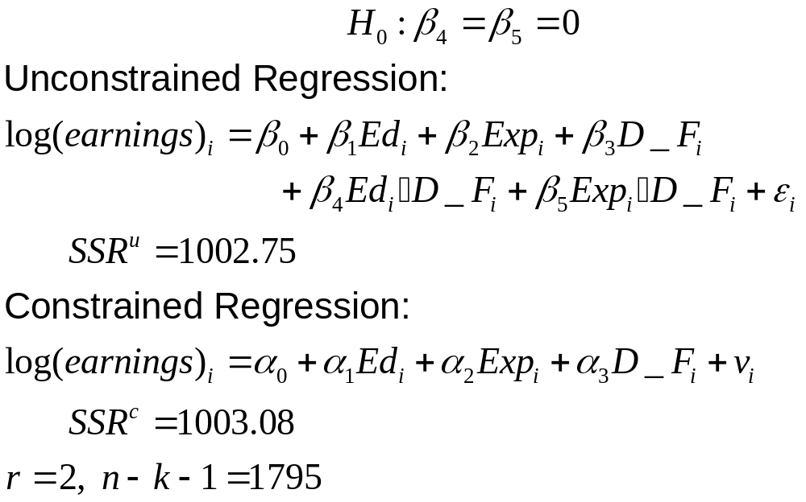
An Application of F-tests (cont.)

Slide 55
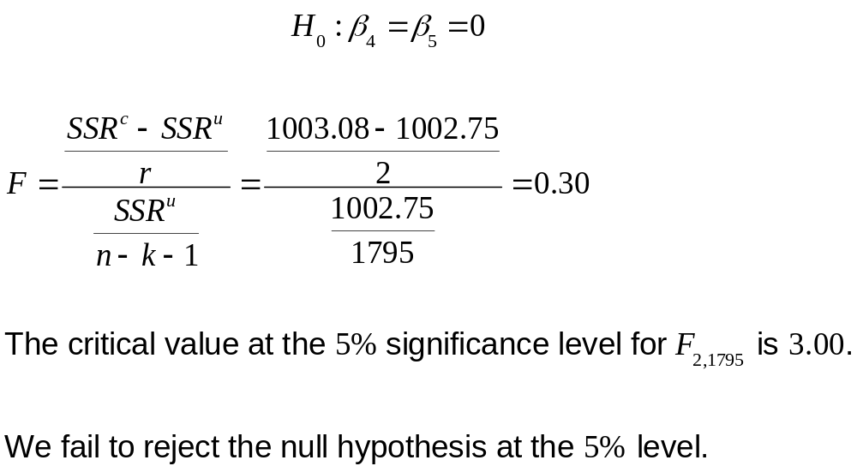
An Application of F-tests (cont.)

Slide 56
F-tests and Regime Shifts (Chapter 9.6)
What is the relationship between Federal budget deficits and long-term interest rates?
We have time-series data from 1960–1994.

Slide 57
F-tests and Regime Shifts (cont.)
Our dependent variable is long-term interest rates (LongTerm_{t})
Our explanators are expected inflation (Inflation_{t}), short-term interest rates (ShortTerm_{t}), change in real per-capita income (DeltaInc_{t}), and the real
per-capita budget deficit (Deficit_{t}).

Slide 58
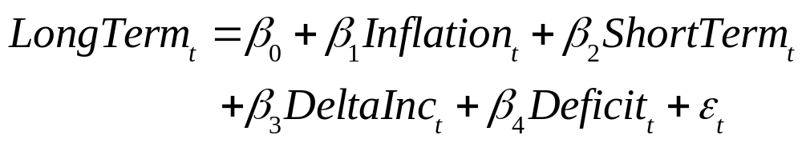
F-tests and Regime Shifts (cont.)
Note that we index observations by t, not i.
β₄ is the change in long-term interest rates from a
$1 increase in the Federal deficit (measured in
1996 dollars).
Financial market de-regulation began in 1982.
Was the relationship between long-term interest rates and Federal deficits altered by the de-regulation?

Slide 59
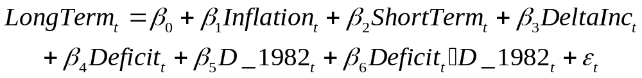
F-tests and Regime Shifts (cont.)
We can let the co-efficient on Deficit_{t} vary before and after 1982 by interacting with a dummy variable.
Create the variable D_1982_{t} = 1 if the observation is for year 1983 or later
To test whether the slope on Deficit_{t} changes after 1982, conduct a t-test of the hypothesis H₀ : β₆ = 0

Slide 60
F-tests and Regime Shifts (cont.)
Dependent Variable: LongTerm_{t}
Independent Variables, with standard errors
Inflation_{t}: 0.765 (0.0372)
ShortTerm_{t}: 0.822 (0.0586)
DeltaInc_{t}: -6.4·10⁻⁶ (1.6·10⁻⁴)
Deficit_{t}: 0.002 (0.0004)
D_1982_{t}: -0.739 (0.6608)
Deficit_{t}·D_1982_{t}: 0.0005 (0.0007)
Constant: 1.277 (0.2135)

Slide 61
F-tests and Regime Shifts (cont.)
For the period 1960–1982, the slope on Deficit_{t} is 0.0022. A $1 increase in the Federal deficit per capita increases long-term interest rates by 0.0022 points.
For the period 1983–1994, the slope on Deficit_{t} is 0.0022 + 0.0005 = 0.0027.
The t-statistic for Deficit_{t}·D_1982_{t} is 0.63.
We fail to reject the null hypothesis that the slopes are different.

Slide 62
F-tests and Regime Shifts (cont.)
For the period 1960–1982, the slope on Deficit_{t} is 0.0022. A $1 increase in the Federal deficit per capita increases long-term interest rates by 0.0022 points.
Is this change important in magnitude?
One quick, crude way to assess magnitudes is to ask, “How many standard deviations does Y change when I change X by 1 standard deviation?”

Slide 63
F-tests and Regime Shifts (cont.)
Standard Deviation of Deficit_{t} = 463
Standard Deviation of LongTerm_{t} = 2.65
A 1-standard-deviation change in Deficit_{t} is predicted to cause a 463·0.0022 = 1.02 percentage point change in LongTerm_{t}, or about a third of a standard deviation
At first glance, the effect of Federal deficits
on interest rates is non-negligible, but not massive, either.

Slide 64
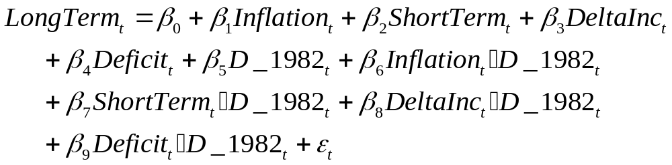
F-tests and Regime Shifts (cont.)
Let’s test a more complicated hypothesis.
Does the entire financial regime shift
after 1982?
Let’s let every coefficient vary between the two time periods.

Slide 65

F-tests and Regime Shifts (cont.)
Does the entire financial regime shift
after 1982?
Test the joint hypothesis that every interaction term is 0:
We need an F-test
There are 5 equal signs, so r = 5

Slide 66
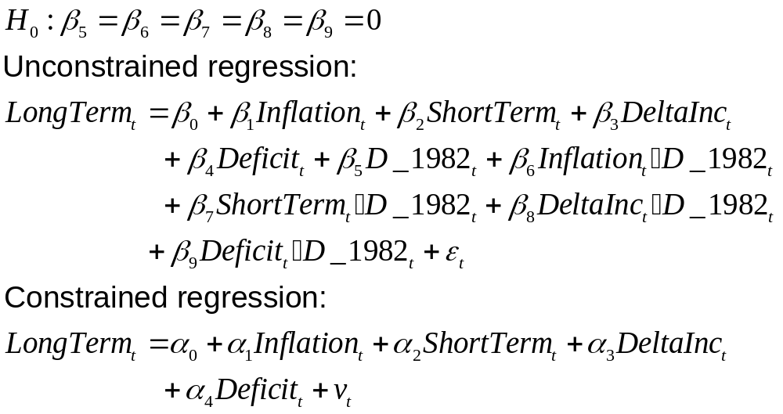
F-tests and Regime Shifts (cont.)

Slide 67
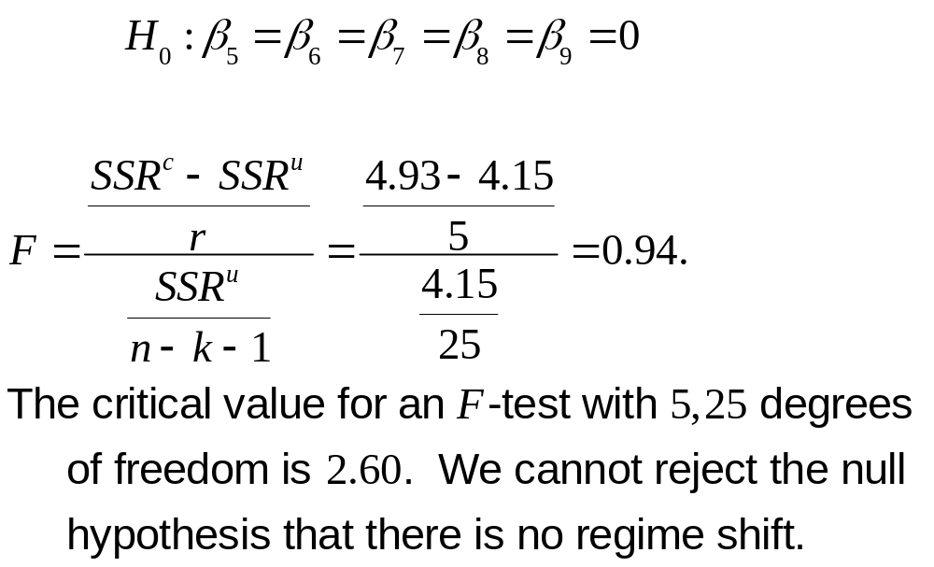
F-tests and Regime Shifts (cont.)

Slide 68
F-tests and Regime Shifts (cont.)
Instead of using dummy variables, we could conduct this same test by running the same regression on 3 separate datasets.
For the constrained regression (there is no regime shift), we use all the data, 1960–1994.
For the unconstrained regression (there is a regime shift), we run separate regressions for 1960–1982 and 1983–1994.

Slide 69
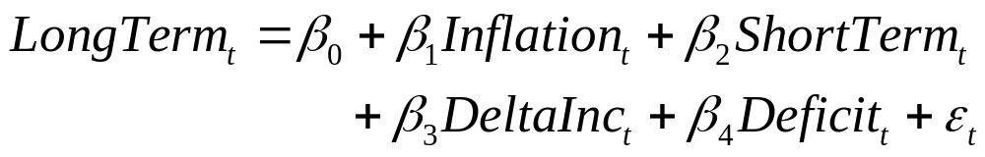
F-tests and Regime Shifts (cont.)

Slide 70
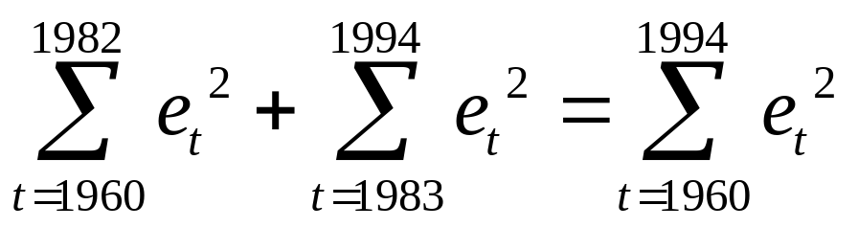
F-tests and Regime Shifts (cont.)
For each regression, we record the SSR
SSR^{c} is the SSR from the regression for 1960–1994, SSR^{1960–1994}
SSR^{u} is the sum SSR^{1960–1982} + SSR^{1983–1994}
Using these SSR ’s, we can compute F

Slide 71
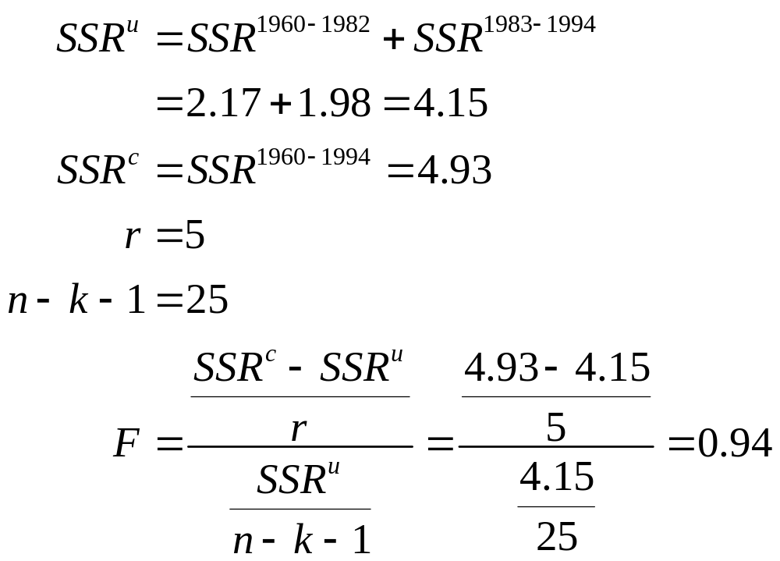
F-tests and Regime Shifts (cont.)

Slide 72
F-tests and Regime Shifts (cont.)
See Chapter 9.7 for additional tests for regime shifts.

Slide 73
Review
How can we test multiple conditions simultaneously?
Intuition: run a regression normally, and then also run a regression where you constrain the parameters to make the null hypothesis true. See if imposing the conditions makes a big difference.

Slide 74
Review (cont.)
Does imposing the restrictions from our null hypothesis greatly increase the SSR ? (Remember, we want a low SSR.)
Run both regressions and calculate the SSR
Call the SSR for the unrestricted version
the SSR^{u}
Call the SSR for the restricted version
the SSR^{r}

Slide 75
Review (cont.)
Run both regressions and calculate the SSR
Call the SSR for the unrestricted version
the SSR^{u}
Call the SSR for the restricted version the SSR^{r}
If the null hypothesis is true, then imposing the restrictions will not change the SSR much. We will have a “small” SSR^{r}-SSR^{u}

Slide 76
Review (cont.)

Slide 77
Review (cont.)
When the ε_{i} are distributed normally, the
F-statistic will be distributed according to the F-distribution with r, n-k-1 degrees of freedom
We know how to compute an F-statistic from the data
We know the distribution of the F-statistic under the null hypothesis
The F-statistic meets all the needs of a
test statistic

Slide 78
Review (cont.)
If our null hypothesis is true, then imposing the hypothesized values as constraints on the regression should not change SSR much. Under the null, we expect a low value of F.
If we see a large value of F, then we can build a compelling case against the null hypothesis.
The F table tells you the critical values of F for different values of r and n-k-1.

